Slide 1

Test

Slide 2
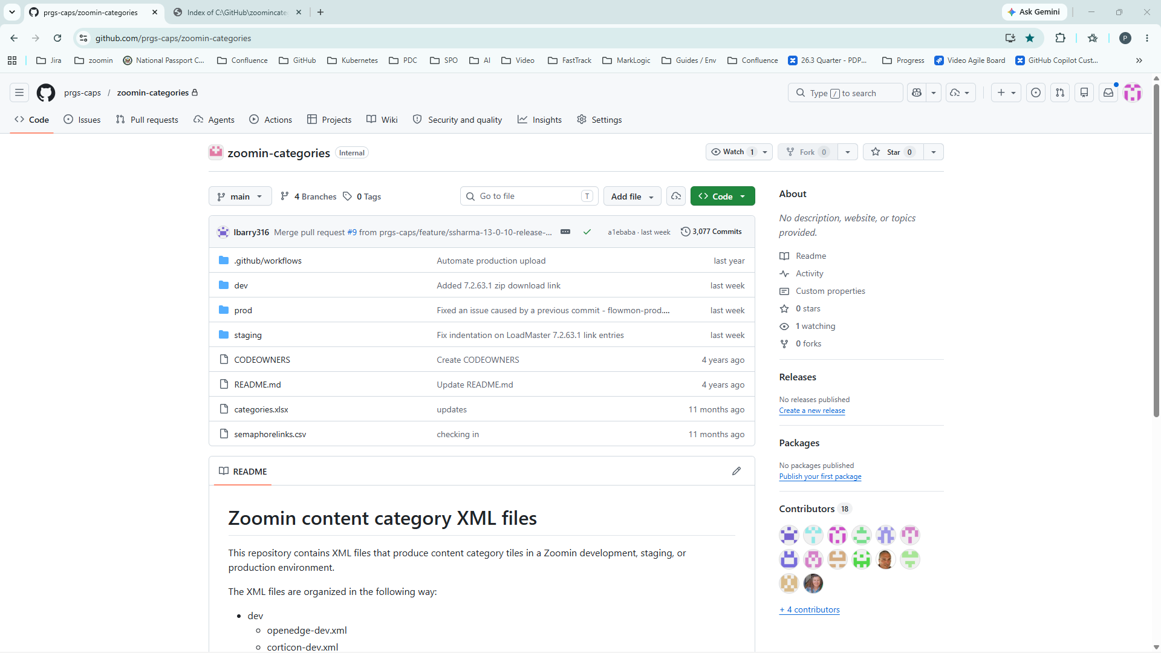
Notes:
D:\GitHub\Video Production Apps\screenshot automater\screenshotautomation\screenshots\20260616_113437_0001.png
Narration for step 1

Slide 3
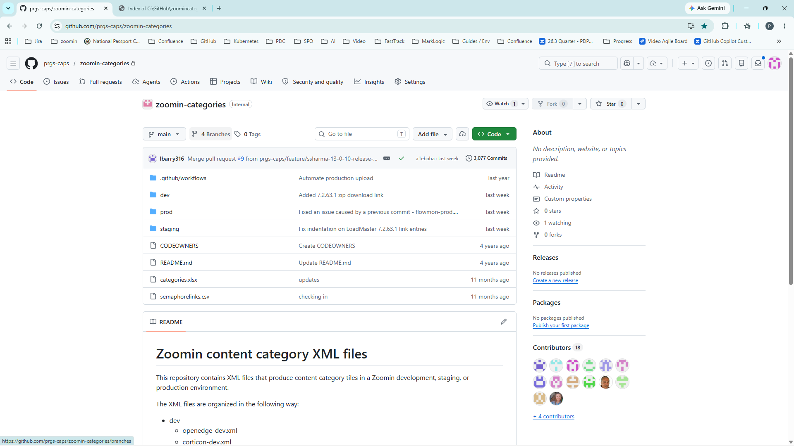
Notes:
D:\GitHub\Video Production Apps\screenshot automater\screenshotautomation\screenshots\20260616_113443_0002.png
Narration for step 2

Slide 4
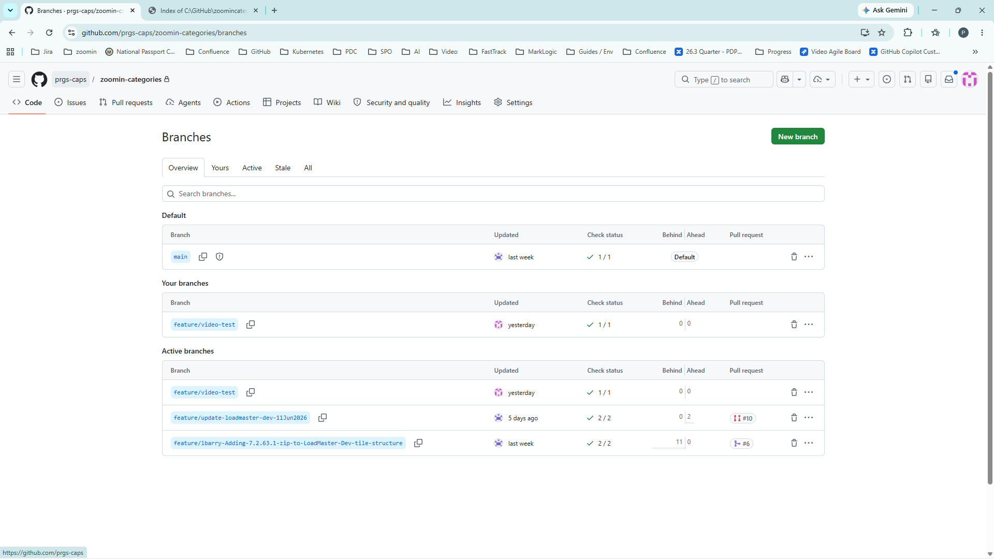
Notes:
D:\GitHub\Video Production Apps\screenshot automater\screenshotautomation\screenshots\20260616_113448_0003.png
Narration for step 3

Slide 5
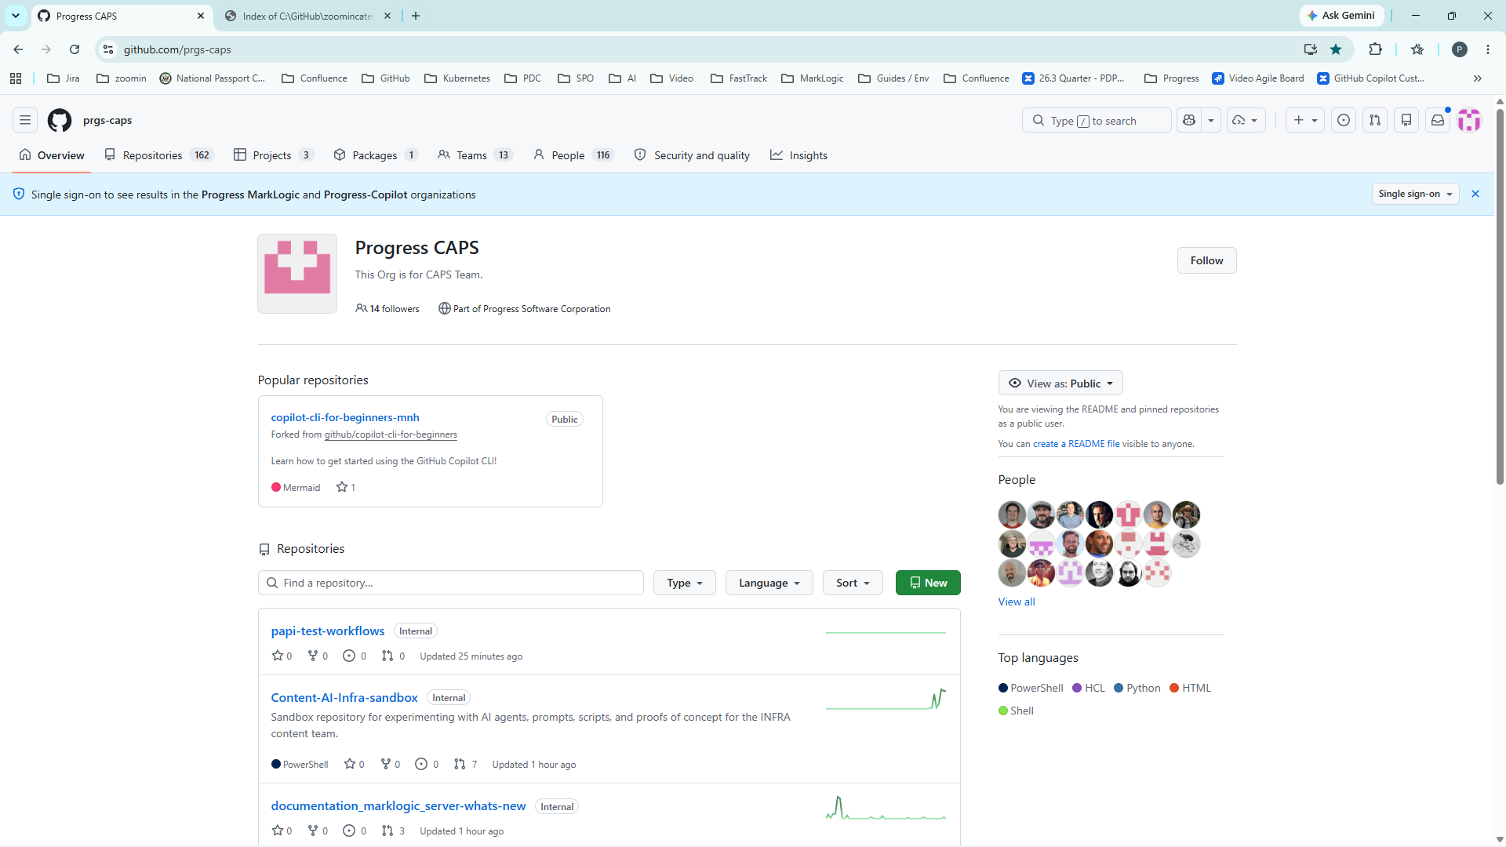
Notes:
D:\GitHub\Video Production Apps\screenshot automater\screenshotautomation\screenshots\20260616_113452_0004.png
Narration for step 4

